Slide 1
Contents
Basic concepts of software testing
Software testing technology(method)
Software testing process(content)
Software testing automation
Software testing management
Software maintenance
School of Software Engineering of South China University of Technology LiuGuixi

Slide 2
Basic concepts of software testing
A crash is when your competitor’s program dies.崩溃
When your program dies, it is an “idiosyncrasy”.特质
School of Software Engineering of South China University of Technology LiuGuixi

Slide 3
Basic concepts of software testing
1 Software Testing Background
2 The Software Development Process
3 The Realities of Software Testing
School of Software Engineering of South China University of Technology LiuGuixi

Slide 4
1. Software Testing Background
How software bugs impact our lives
What bugs are and why they occur
Who software testers are and what they do
School of Software Engineering of South China University of Technology LiuGuixi

Slide 5
Infamous Software Error Case Studies
Patriot Missile Defense System, 1991
The Y2K (Year 2000) Bug, circa 1974
Dangerous Viewing Ahead, 2004
School of Software Engineering of South China University of Technology LiuGuixi

Slide 6
The Software Industry
The software industry has come a long way since its beginnings in the 1950’s.
Software products for mass consumption arrived in 1981 with the arrival of PC-based software packages.
Numerous examples exist of the results of failures in software quality and the costs it can incur.
School of Software Engineering of South China University of Technology LiuGuixi

Slide 7
Software Engineering as a discipline grew out of the “Software Crisis”.
Projects were running over-budget
Projects were running over-time
The Software products were of low quality
The Software products often did not meet their requirements
Projects were chaotic
Software maintenance was very difficult
School of Software Engineering of South China University of Technology LiuGuixi

Slide 8
Software Testing and Quality
Proper software testing procedures reduce the risks associated with software development.
Poor quality leads to increased software failures, increased development costs, and increased delays in releasing software.
More severe outcomes for a business can be a loss of reputation, leading to reduced market share,or even to legal claims.
School of Software Engineering of South China University of Technology LiuGuixi

Slide 9
What Is a Bug?
Defect | Variance
Fault | Failure
Problem | Inconsistency
Error | Feature
Incident | Bug
Anomaly
Product Anomaly Reports (PARs)
Product Incident Reports (PIRs)
School of Software Engineering of South China University of Technology LiuGuixi

Slide 10
Software Bug: A Formal Definition
1. Doesn’t do something it should do.
Does something it shouldn’t do.
Does something it doesn’t mention.
Doesn‘t do something it doesn’t mention but should.
It’s difficult to understand, hard to use, slow, or——in the software tester's eyes——will be viewed by the end user as just plain not right.
product specification
School of Software Engineering of South China University of Technology LiuGuixi

Slide 11
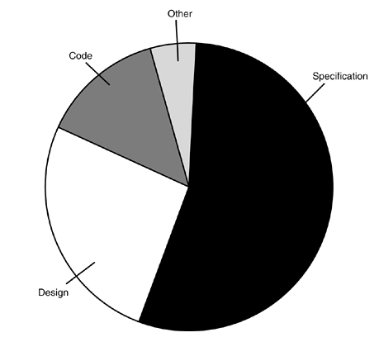
Why Do Bugs Occur?
10%
7%
56%
27%
School of Software Engineering of South China University of Technology LiuGuixi

Slide 12
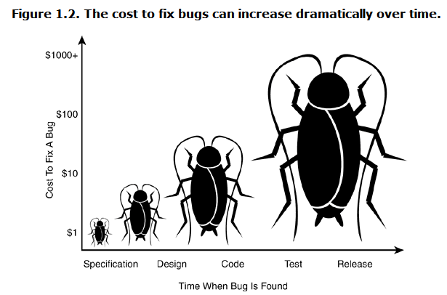
The Cost of Bugs
School of Software Engineering of South China University of Technology LiuGuixi

Slide 13
What Exactly Does a Software Tester Do?
● The goal of a software tester is to find bugs.
● The goal of a software tester is to find bugs and find them as early as possible.
● The goal of a software tester is to find bugs, find them as early as possible, and make sure they get fixed.
School of Software Engineering of South China University of Technology LiuGuixi

Slide 14
What Makes a Good Software Tester?
● relentless
● creative
● good judgment
● tactful and diplomatic
● persuasive
●software programming
●expert in non-computer field
School of Software Engineering of South China University of Technology LiuGuixi

